Slide 1
Salary Range Prediction for Job listings
Using Machine Learning Models By Ritesh Kumar

Slide 2
Introduction
In today’s competitive job market, determining appropriate salary ranges is a crucial aspect of the recruitment process. Organizations often face challenges in setting fair and competitive salaries due to variations in job roles, experience levels, and market trends. Inaccurate salary estimation can lead to poor hiring decisions and reduced candidate satisfaction.
Therefore, there is a need for a reliable and data-driven approach to estimate salary ranges more effectively.
OVERVIEW
This project focuses on predicting salary ranges for job listings using machine learning techniques.
The goal is to build a model that can estimate minimum and maximum salaries based on job-related features.
Key Benefits:
• Improves hiring decisions
• Enhances salary transparency
• Supports data-driven insights

Slide 3
Dataset Overview
Dataset: NYC Job Postings Dataset The dataset consists of 5,120 job listings and includes 30 features capturing detailed information about job roles, organizational structure, and salary details. It contains both structured and textual data related to job postings, such as job titles, agencies, categories, locations, and required skills. Key Features: • Job-related attributes: Job Title, Agency, Posting Type, Job Category • Organizational details: Division/Unit, Work Location, Career Level • Text-based information: Job Description, Preferred Skills, Qualification Requirements • Salary attributes: Salary Range From and Salary Range To Target Variables: • Minimum Salary (Salary Range From) • Maximum Salary (Salary Range To) This dataset provides a comprehensive foundation for building machine learning models to predict salary ranges accurately based on job-specific features.

Slide 4
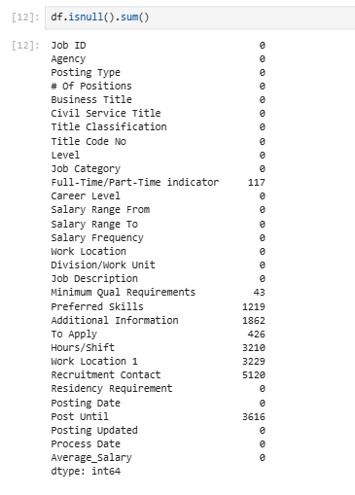
DATA PREPROCESSING
To ensure high-quality input for model building, several preprocessing steps were performed on the dataset.
• Missing Values Analysis: Missing values were identified using df.isnull().sum(). Columns with high missing values such as Preferred Skills, Additional Information, Hours/Shift, and Work Location 1 were handled appropriately by either filling or removing them.
• Dropping Irrelevant Columns: Columns such as Job ID, Recruitment Contact, Posting Dates, Process Date, and other non-informative fields were removed as they do not contribute to salary prediction.
• Handling Missing Data:
Categorical features such as Preferred Skills, Minimum Qualification Requirements, and Additional Information were filled with empty strings. - The Full-Time/Part-Time indicator was filled using the mode value. - Columns with a high proportion of missing values, such as Hours/Shift and Work Location 1, were removed from the dataset.
• Removing Duplicates: Duplicate records (31 rows) were identified and removed to maintain data integrity.
Additionally, a new feature called "Average Salary" was created using Salary Range From and Salary Range To to support further analysis and modeling.
These preprocessing steps resulted in a clean, structured, and reliable dataset, which is essential for building accurate and robust machine learning models.

Slide 5
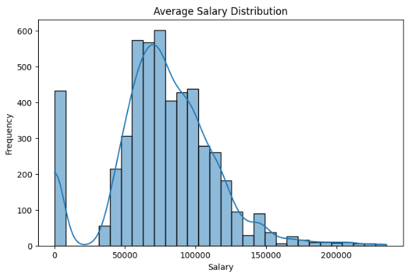
Exploratory Data Analysis (EDA)
EDA was performed to understand the distribution of salary values and identify key patterns and relationships in the dataset.
Salary Distribution
The histogram illustrates the distribution of average salary across job listings.
Salary values are primarily concentrated within the range of 50,000 to 100,000.
The distribution is positively skewed, indicating the presence of higher salary values.
A few job roles have very high salary values, indicating outliers .
A small number of lower salary values are also observed in the dataset.
This analysis helps in understanding salary patterns and identifying outliers .

Slide 6
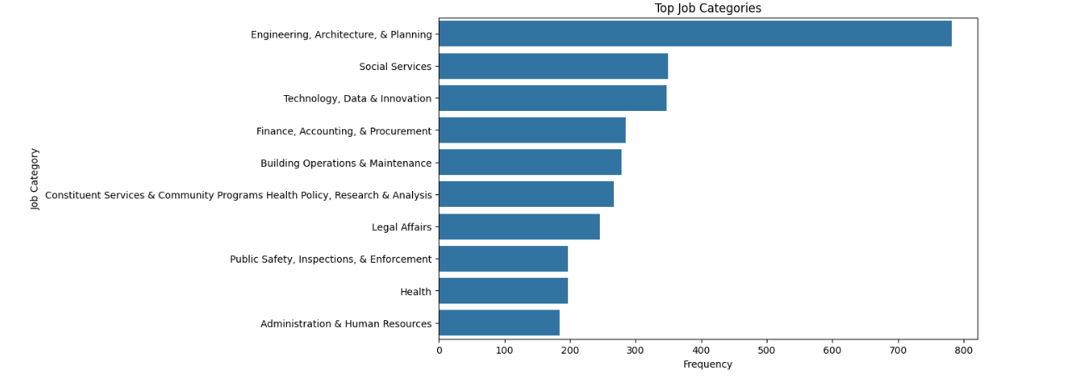
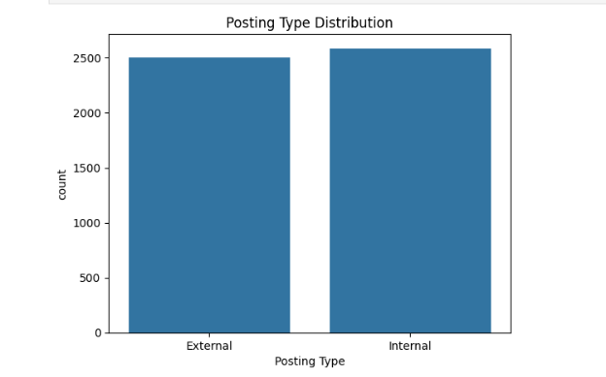
Top Job Categories:
Engineering, Architecture & Planning is the most dominant job category .
Other major categories include Social Services and Technology, Data & Innovation .
Indicates higher demand for technical and public service roles .
Posting Type Distribution:
Internal and External job postings are nearly balanced .
Slight variation indicates consistent hiring across both categories.
Reflects stable recruitment patterns in the dataset.

Slide 7
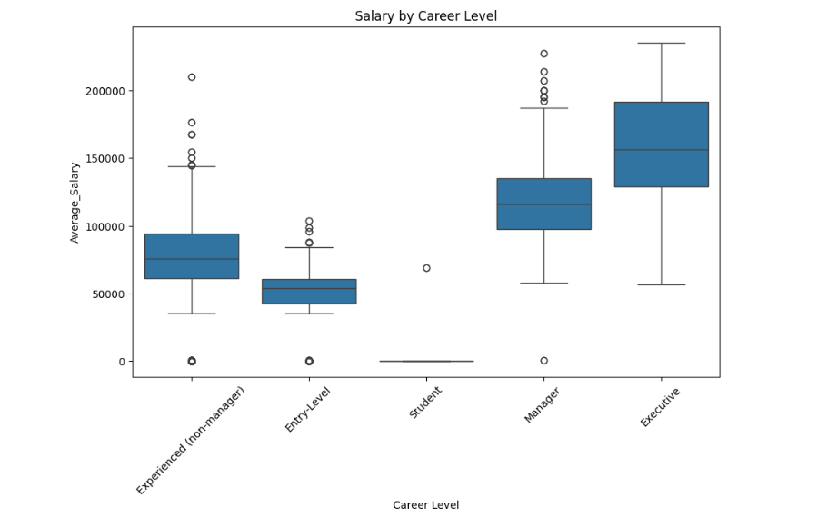
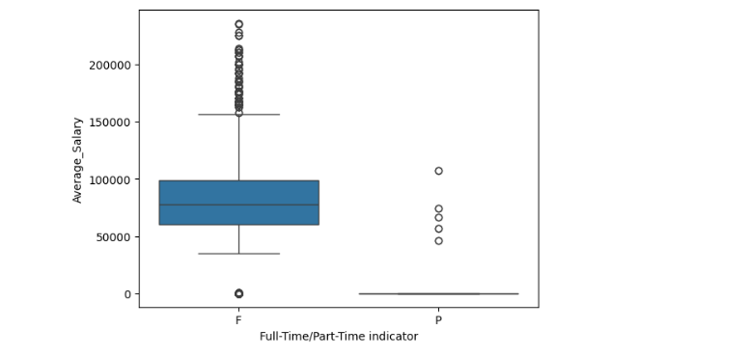
Salary by Career Level:
Salary increases significantly with higher career levels .
Executive and Manager roles have the highest salary ranges .
Entry-level and student roles show comparatively lower salaries .
Salary variability is higher in senior roles, indicating wider pay distribution.
Outliers are present across multiple levels, reflecting exceptional salary cases .
Salary vs Full-Time / Part-Time:
Full-time roles (F) show significantly higher salary levels compared to part-time roles (P) .
Salary distribution for full-time positions is wider, indicating greater variability.
Part-time roles are concentrated at lower salary ranges.
Median salary for full-time roles is substantially higher than part-time roles.
This highlights the strong influence of employment type on salary structure .

Slide 8
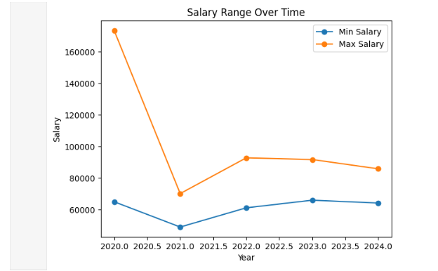
Salary Range Trend Over Time:
The graph illustrates the trend of minimum and maximum salary over time .
Both salary components show a similar pattern across the years .
A sharp decline is observed in 2021, followed by gradual recovery .
The gap between minimum and maximum salary remains relatively consistent.
This indicates stability in salary range structure over time .

Slide 9
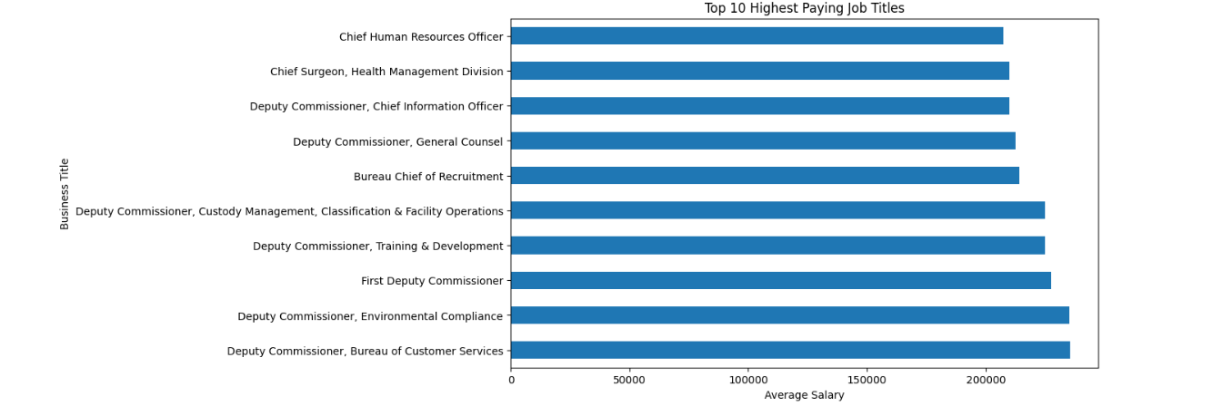
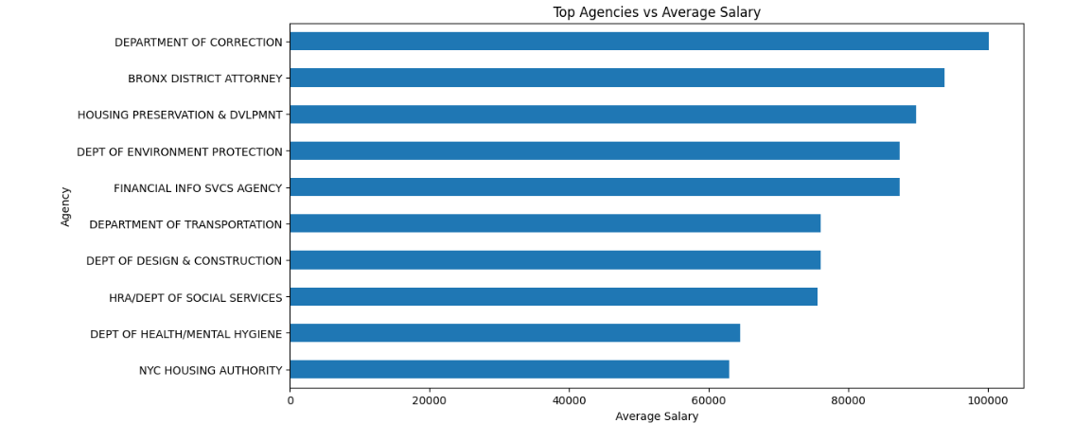
Top 10 Highest Paying Job Titles:
The chart highlights the top 10 highest paying job roles in the dataset .
Senior-level and executive positions dominate the highest salary brackets.
Leadership roles such as Chief Officers and Deputy Commissioners offer significantly higher salaries .
Indicates that salary increases with higher responsibility and seniority .
Reflects strong demand and value for leadership and specialized roles.
Top Agencies by Average Salary:
The chart shows agencies offering the highest average salaries .
Certain government departments consistently offer higher compensation .
Agencies like Department of Correction and Bronx District Attorney stand out in terms of salary.
Salary variation across agencies reflects differences in job roles and responsibilities .
Helps identify high-paying organizations within the dataset.

Slide 10
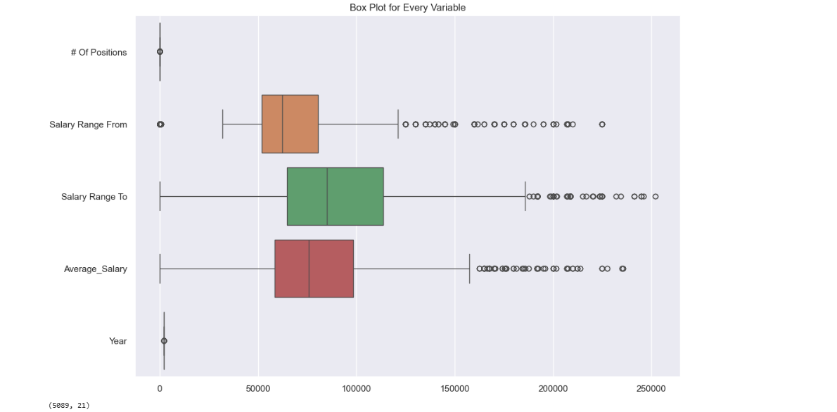
Outlier Detection and Treatment
•Box plots were used to identify outliers in key numerical features . • Significant outliers were observed in Salary Range From, Salary Range To, and Average Salary. • The Interquartile Range (IQR) method was applied for outlier detection . • Lower and upper bounds were calculated using q1, q3, and IQR . • Outliers were handled using clipping (capping values within defined bounds) instead of removing rows. • This approach preserved dataset size while reducing the impact of extreme values.

Slide 11
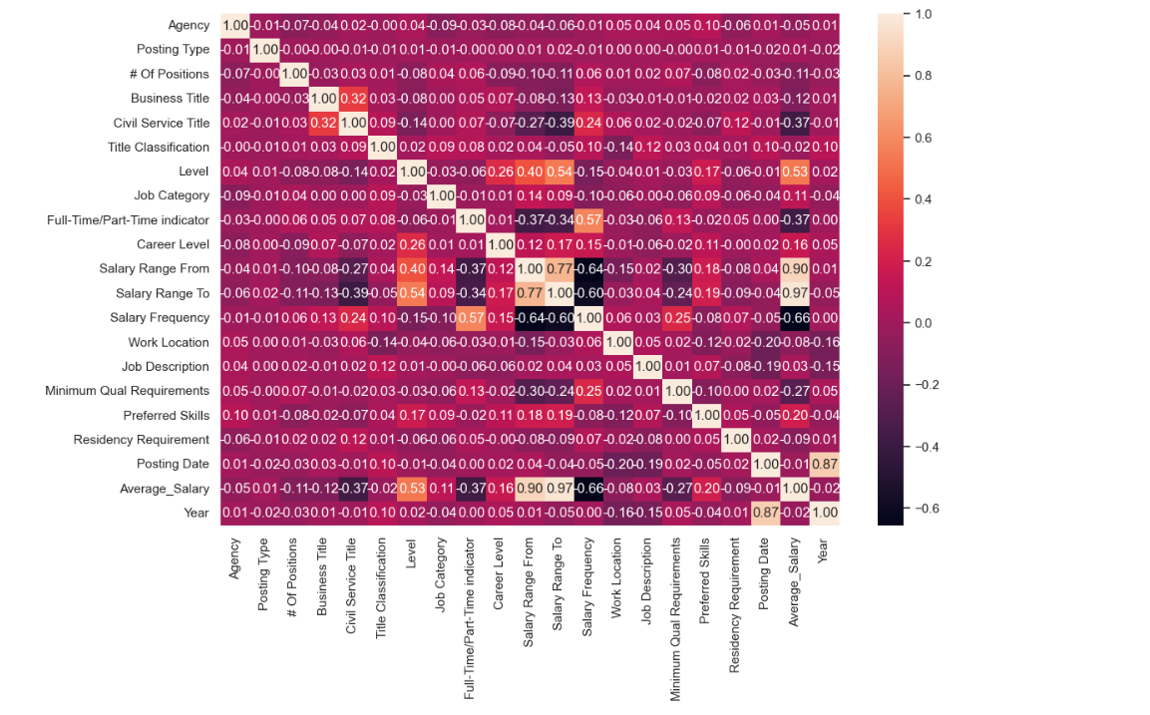
Feature Encoding and Correlation Analysis
• Categorical variables were converted into numerical form using Label Encoding. • This transformation enabled machine learning models to process categorical data effectively . • A correlation heatmap was generated to analyze relationships between features . • Strong positive correlation is observed between Salary Range From, Salary Range To, and Average Salary. • High correlation among salary features indicates potential multicollinearity. • This analysis helps in identifying important features for model building .

Slide 12
Model Building and Data Preparation
The dataset was prepared by separating input features (X) and target variable .
Average Salary was initially used as the target variable to understand overall salary trends.
Irrelevant features such as posting dates were removed .
Salary-related features were excluded during training to avoid data leakage .
The dataset was split into training and testing sets using an 80-20 ratio .
Separate target variables were defined for minimum and maximum salary.
Salary Range From and Salary Range To were used as target variables .
A new feature set was created by removing salary-related columns .
Separate models were trained to predict minimum and maximum salary .
The dataset was split into training and testing sets for both targets .
This approach enables accurate prediction of salary ranges instead of a single value .

Slide 13
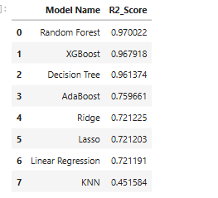
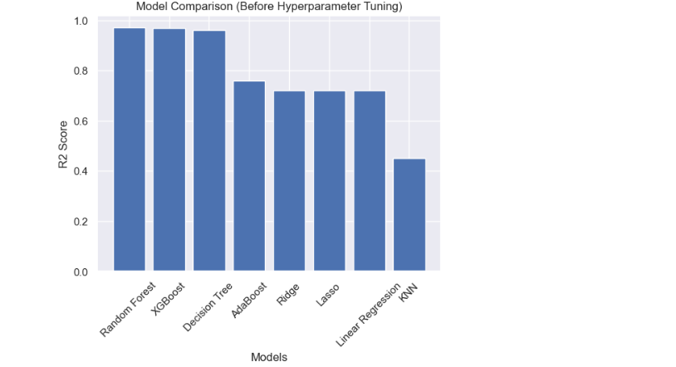
Model Comparison and Performance Analysis
• Multiple regression models were implemented to evaluate performance, including Linear Regression, Lasso, Ridge, KNN, Decision Tree, Random Forest, XGBoost, and AdaBoost .
• Models were trained on the training dataset and evaluated on unseen test data .
• Performance was measured using RMSE, MAE, and R² Score to ensure reliable comparison .
• Random Forest achieved the highest R² score (~0.97), indicating strong predictive capability .
• XGBoost also performed competitively with similar accuracy .
• Decision Tree showed high training accuracy but indicated overfitting.
• Linear models demonstrated moderate performance, while KNN showed the lowest accuracy .
• Ensemble models outperformed traditional models, highlighting their effectiveness for this problem .

Slide 14
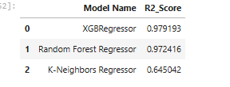
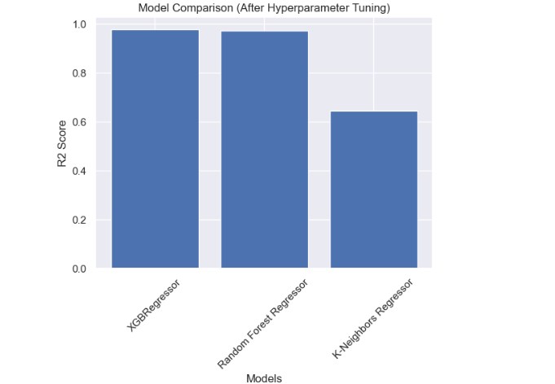
Hyperparameter Tuning and Final Model Selection
• Hyperparameter tuning was performed using Randomized Search with cross-validation .
• Key models such as KNN, Random Forest, and XGBoost were optimized .
• The best parameters were selected based on model performance .
• After tuning, XGBoost achieved the highest R² score (~0.98).
• Random Forest also showed strong performance with slightly lower accuracy .
• KNN performance improved but remained lower compared to other models.
• XGBoost was selected as the final model due to its superior accuracy and generalization ability .
• Cross-validation confirmed the model stability with consistent performance.

Slide 15
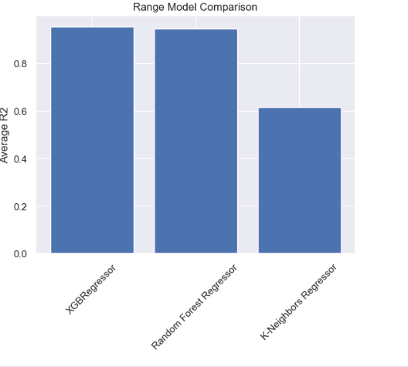
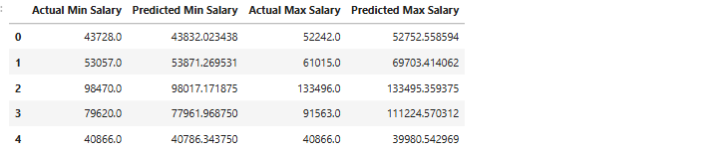
Salary Range Prediction (Min & Max)
• Separate models were trained to predict minimum and maximum salary values . • XGBoost was used due to its superior performance after tuning . • The model achieved high accuracy for both predictions . • Minimum Salary R²: ~0.92 • Maximum Salary R²: ~0.98 • The model effectively captures salary patterns and variations .
• The table shows a comparison between actual and predicted salary values . • Predicted values are very close to actual values, indicating high model accuracy . • This validates the effectiveness of the model in real-world scenarios.

Slide 16
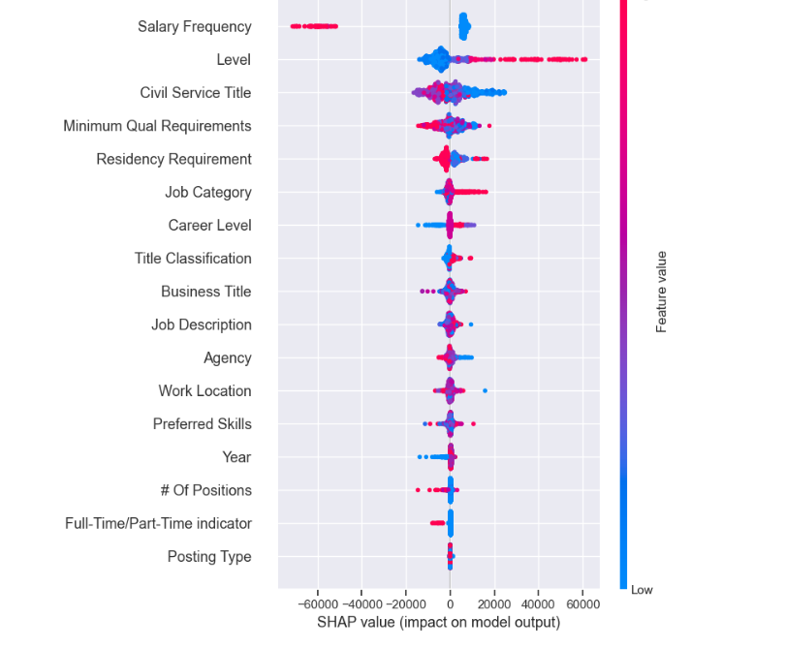
Model Interpretation, Validation and Model saved
• SHAP was used to interpret model predictions and understand feature importance .
• Key features such as Salary Frequency, Level, and Civil Service Title have the highest impact on salary prediction .
• Error analysis was performed to evaluate model performance .
• The error plot shows that most prediction errors are centered around zero, indicating good model accuracy .
• No strong pattern in residuals suggests that the model is well-fitted and unbiased .
• The trained models were saved using the joblib library for future use.

Slide 17
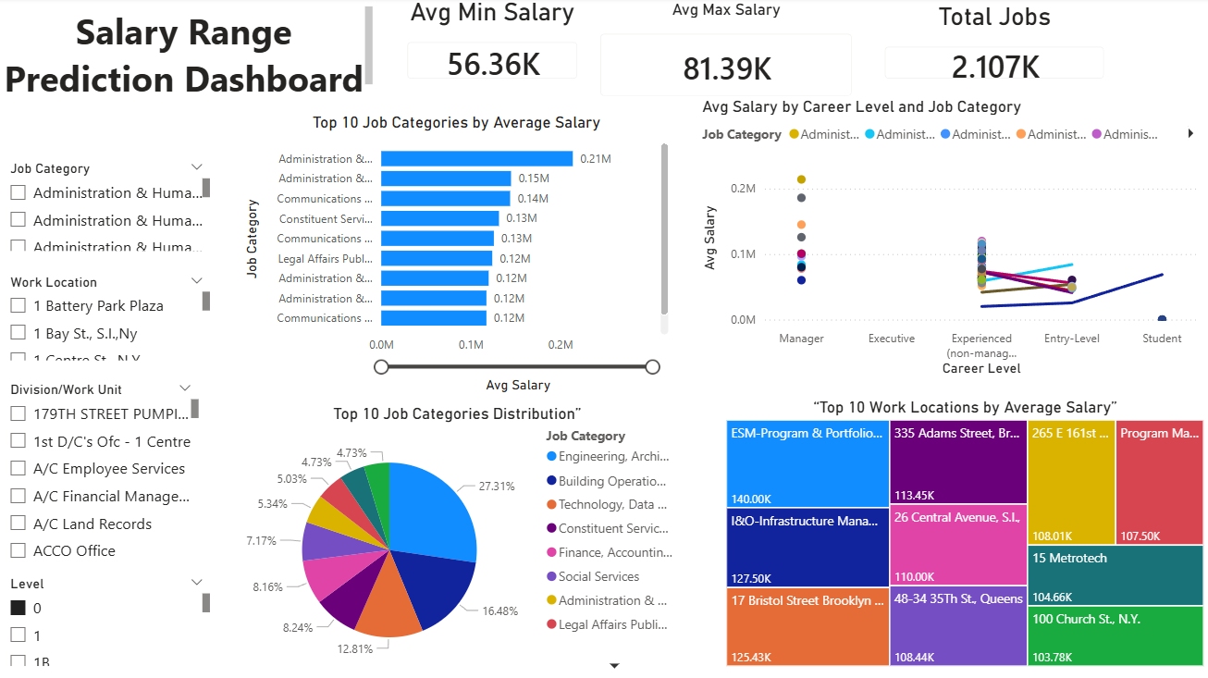

Slide 18
Conclusion and Future Scope
• A machine learning model was successfully developed to predict salary ranges (minimum and maximum) .
• XGBoost achieved the best performance with high accuracy and strong generalization ability .
• The model effectively captures relationships between job features and salary .
• Predicted salary values closely match actual values, indicating reliable performance .
• This solution can support better hiring decisions by providing accurate and transparent salary estimates .
FUTURE IMPROVEMENTS
• Remove direct salary-related features to improve model generalization . • Apply advanced NLP techniques on job descriptions for deeper insights. • Explore deep learning models for improved feature representation . • Deploy the model as a web application using Streamlit or Flask .

Slide 19
THANK YOU

